Slide 1
The
Insider Experience:
EXPLORING YOUR MEMBER BENEFITS
Notes:
Hello and welcome to the DATAVERSITY Insider Experience: Exploring Your Member Benefits Webinar.
I'm your host Cassie Riendeau.
I am so excited to share the DATAVERSITY Insider Program and to show you how we can help you grow your skillset and expand your knowledge as a Data Management Professional.

Slide 2
TRAINING.DATAVERSITY.NET
1.
3.
Who Is DATAVERSITY?
Trends in Data Management?
Learn about who we are and what we do
2.
Businesses need professionals knowledgeable about data – whether your role is data-focused or not!
4.
How to Become and Insider?
What Is an Insider?
Learn more about the perks of becoming an Insider and how to make the most out of your subscription.
Learn about our subscription options and which one may be best for you.
What to expect today
Notes:
our Agneda today includes:
•Who is DV
Many of you might be joining us because you have participated in other trainings or events- or maybe you're completely new here and you want to see everything we have to offer.
We'll also cover
•Who is DV – read
What is an Inisder
We’ll also cover why education matters and what we are seeing in the field of DM
Why becoming an insider can offer you the opportunity to grow with the industry – a short demo of our dashboard and more!

Slide 3
Who Is DATAVERSITY?
The DATAVERSITY mission is to provide the single best source of education for anyone working with data in their professional life.
Notes:
at DV- Our mission is to provide the single best source of education for anyone working in data in their professional life.
And how we do that??
Well, we bring you live in person conferences such as DGIQ, EDW – bringing together those in the data fields.
We also have our
Interactive online conferences like EAO and DAO (say full names) where _________
Free online resources such as white papers, Webinars and My Career in Data, a podcast that focuses on how those in the field of data came into their career.
Lastly- we have our DATAVERSITY Training Center. Here is where you’ll find comprehensive on-demand and live online training and most importantly, where you’ll gain access as an Insider.

Slide 4
What we do
In-person events
Digital events
Podcasts and
trade journal
Online training
Notes:
Well, we bring you live in person conferences such as Data Governance Information and Quality twice a year and Enterprise Data World also twice a year.
We have our
Interactive online conferences like Enterprise Analytics Online and Data Architecture Online and Enterprise Data Governance online.
You may also be familiar with some of our other -Free online resources such as white papers, Webinars and My Career in Data podcast and our trade journal.
Lastly, but not least our DATAVERSITY Training Center. Here is where you’ll find comprehensive on-demand and live online training and most importantly, where you’ll gain access as an Insider

Slide 5
What Is an Insider?
Insiders are an exclusive group of learners taking advantage of the robust DATAVERSITY Training Center catalog by enrolling in a subscription plan.
Insiders receive unlimited access to materials through their subscription term, plus exclusive discounts, special content, and more.
TRAINING.DATAVERSITY.NET
Notes:
Now that you know a little bit more about DATAVERSITY as a whole let's dig into what exactly is an insider?
Insiders are a group of learners taking advantage of our unlimited, on-demand catalog, special content, and exclusive discounts. Sounds pretty great right?
All of this to say we understand the impact of quality, professional training that you can put into practice. And we also understand that most of you have busy professional and personal lives.
So, with that in mind, we bring you the Insider Experience through either the Professional Subscription or Elite Subscription.
Essentially…Insiders get more!

Slide 6
TRAINING.DATAVERSITY.NET
Lead the way
As an Insider you are equipped with the right tools all in one place to meet the ever-changing demands of industries across the globe.
“As organizations continue to expand their data practices, fundamentals such as Data Governance and Data Architecture will become business-as-usual activities with both business and technical resources becoming more proficient in the language of data to drive organizational success.”
– Trends in Data Management: A 2022 DATAVERSITY Report
Notes:
Now that you know more about what an insider is, let's discuss why we created the program.
The Data Management landscape is becoming vastly more important as organizations and businesses continue to make Data Governance initiatives a priority. ---- Which is likely why many of you are joining us today.
So, as an Insider you'll be equipped with the right tools all in one place to meet the challenges and the demands of all types of industries across the globe.
Ok Cassie, great- what does that mean for me-

Slide 7
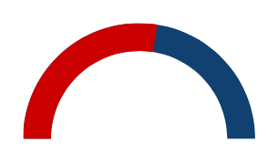
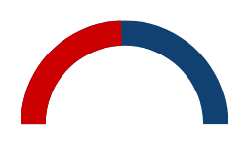
TRAINING.DATAVERSITY.NET
We asked: What programs are you planning to implement withinin the next two years?
Start with
data.
Future-proof your skill-set and expand your career possibilities as an Insider.
58%
55%
49%
Data Governance
Data Quality
Metadata Management
Notes:
Essentially -We START with the DATA
Citing our 2022 trends in DM We have found-
from 181 participants surveyed, from 35 countries, and over 32 industries THAT organizations are focusing their efforts on becoming more data driven due to high demand for leveraging data… no surprise there because PAUSE (big buzz word here) as an asset. Even those that don’t work directly in data know it.
This is important to note because....
as you can see here, in the next two years, 58% of those surveyed are planning on implementing a DG program, 55% are implementing DQ and 49% are implementing Metadata Management programs.
The numbers are staggering...
And yet many are still struggling to find the right training to be able to meet that call to action...

Slide 8
How are you expanding your skills?
And preparing to tackle the ever-changing data landscape?
Notes:
So I ask you this - how are you.
And maybe this is the first step in that process or maybe you have already started and you want to know how to really maximize you experience.

Slide 9
Most popular sources of training
From cobbled together lessons across the web?
Books on Data Management
The top sources of training for industry professionals today are scattered across the internet.
Blogs, webinars, other web sources
Courses outside of university work
Notes:
regardless - I think it's pretty fair to say up until now , we "the collective DM field" has missing one great spot for all DM education resources!
So look no further -
“time is money” Save yourself and your organization the hassle and put that time and effort into your business goals and let DATAVERSITY do the heavy lifting with our subscriptions and dedicated training center team.

Slide 10
Blogs, webinars, other web sources
Courses outside of university work
Books on Data Management
Hundreds of on-demand webinars, individual courses, white papers, demos, and more
Education based on industry standard textbooks, plus recommended reading to further expand your knowledge.
Learning plans designed by adult education specialists to rival university coursework.
... to everything you need in one place
TRAINING.DATAVERSITY.NET
Notes:
We have the resources and platform to yield effective and obtainable results.
We have over 160 courses and growing monthly including 25 learning plans taught by industry experts.
We have the most up to date trends in DM through our webinars, white papers, podcasts and product demos.
Plus recommended readings to further expand your knowledge and expertise.
As an Insider you have all of this right at your fingertips

Slide 11
TRAINING.DATAVERSITY.NET
Insiders get more
Online and Face-to-Face Conference Sessions
20% Discounts on Conferences and Live Courses
Continuing Education Credits​ and Certificates of Completion​
To learn more about the full range of Insider exclusive benefits visit the Subscriptions page.
Notes:
The benefits don't just stop at the on-demand training and access to exclusive content...
You'll also enjoy discounts on our very popular live online training courses, where you'll learn from industry leading experts and participate in live breakout sessions with industry members alike.
As an insider you'll also receive discounts on face-to-face conferences such as Enterprise Data World and DGIQ. It's always nice to put faces to names so if you do attend please come say hello!
We also want to ensure you can keep up with your CEU's and so all of our training comes with a number of completed hours and certificates of completion. Feel free to share on linkedin - We love to see it

Slide 12
Learn from the best
Who are DATAVERSITY instructors? They are...
Vetted thought leaders
With over a decade’s worth of experience
Regularly evaluated by peers on their ability to
deliver comprehensive training
Notes:
Excellent training starts with excellent instructors and subject matter experts.
This is just a small sampling of who we work with - Our instructors come with decades of combined experience in strategy, governance, architecture, quality and so much more.
From dozens of live online master classes held each year to the robust on-demand library you're in good hands with the industry's BEST...and I mean BEST, leading the way!

Slide 13
TRAINING.DATAVERSITY.NET
Industry leading CDMP test preparation
Training options developed in partnership with DAMA International to help you ace your CDMP exam!
Expert led live classes
Self paced on-demand options
Beginner and specialist levels
Notes:
Excellent training starts with excellent instructors and subject matter experts.
This is just a small sampling of who we work with - Our instructors come with decades of combined experience in strategy, governance, architecture, quality and so much more.
From dozens of live online master classes held each year to the robust on-demand library you're in good hands with the industry's BEST...and I mean BEST, leading the way!

Slide 14
TRAINING.DATAVERSITY.NET
Even MORE to explore
We now have a monthly Special Interest Group for Insiders looking to expand their knowledge with a community of learners.
Expert led live, one - hour sessions
Interactive with peers and SME
Monthly to keep you connected
Notes:
Excellent training starts with excellent instructors and subject matter experts.
This is just a small sampling of who we work with - Our instructors come with decades of combined experience in strategy, governance, architecture, quality and so much more.
From dozens of live online master classes held each year to the robust on-demand library you're in good hands with the industry's BEST...and I mean BEST, leading the way!

Slide 15
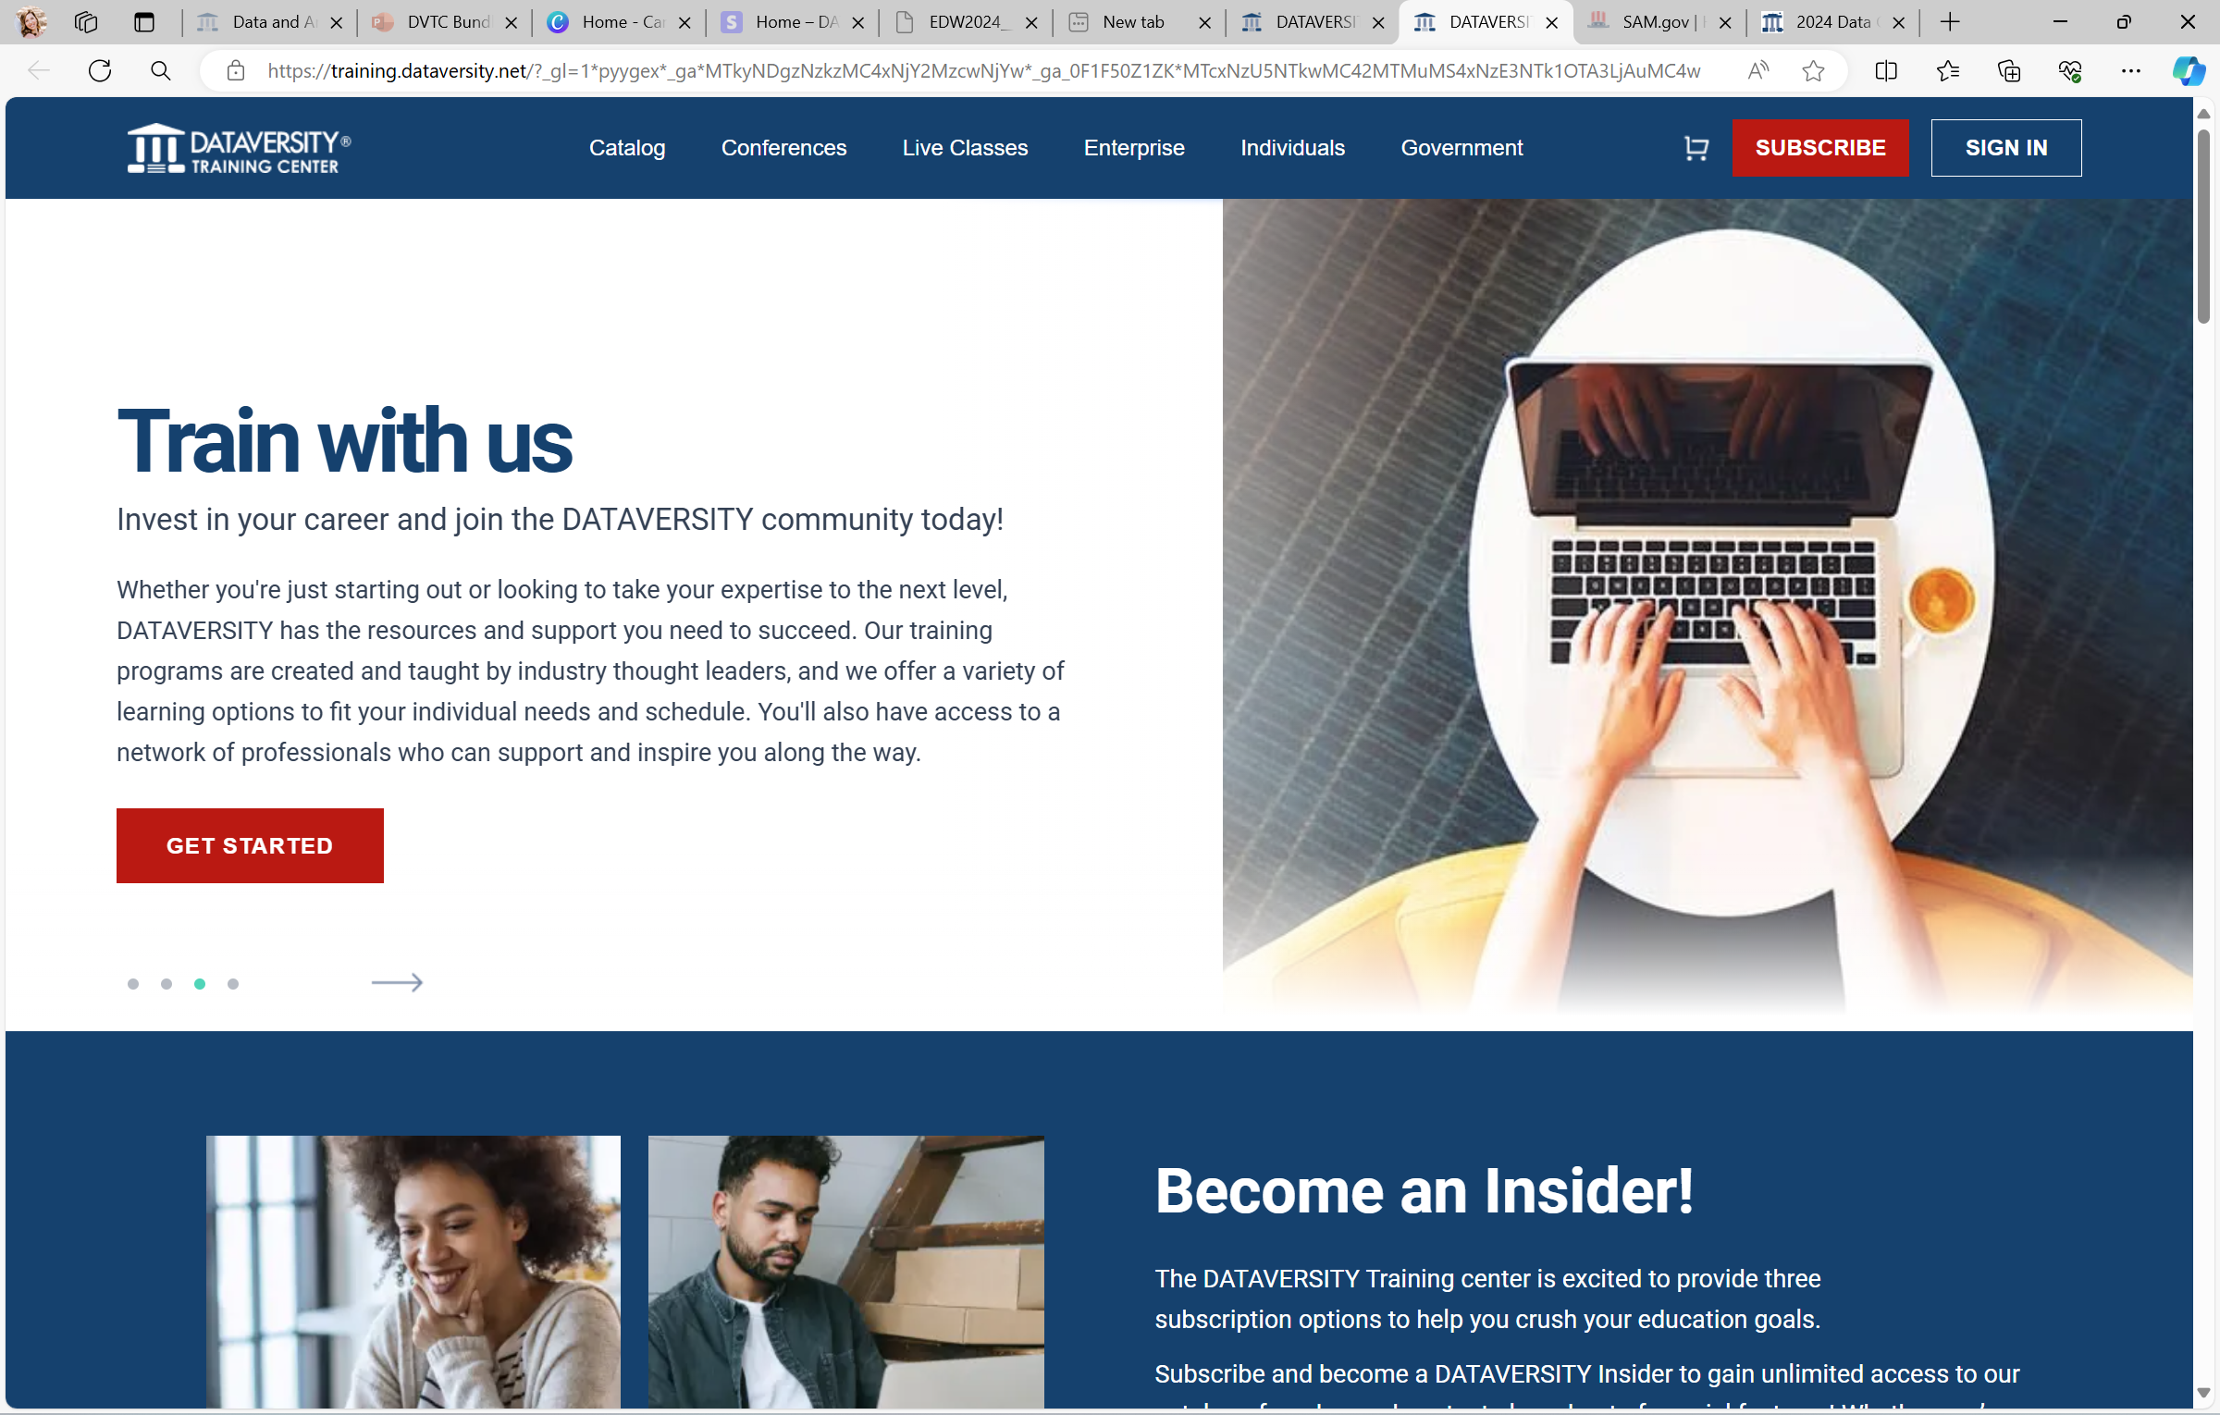
TRAINING.DATAVERSITY.NET
Insider exclusive content
Gain unlimited access to self-paced and easy-to-use educational materials throughout the life of your subscription.
Career success starts here
Notes:
Accessing insider content is easy. Whether you are new to the DVTC or you are a frequent learner you can preview the content available in the insider content tab in out catalog.
But I am going to do you one better and dig into the Insider dashboard, lets take a look.
DEMO

Slide 16
We’re here to help you meet your goals
A learning path is a collection of learning plans and courses designed and tailored to your learning goals.
We can set required and suggested learning plans to follow to keep you on track.
From beginner to advanced to practical use and business use we can help pick what’s right for you.
TRAINING.DATAVERSITY.NET
Notes:
Since our catalog is so robust sometimes you just don't know where to start or you need a little guidance.
We have a great solution in the form of Learning Paths. A learning path, a collection of learning plans to create a cohesive and comprehensive structure to your training. Typically, its persona or skill/ experience level based, but there might be some nuance to that.
Learning paths can be customized or you can choose one of our pre-selected options based on specific skill or role.
Rest assured a member of our Training team is here to help you stay on track and achieve your goals.

Slide 17
TRAINING.DATAVERSITY.NET
Notes:
Speaking of goals-
We have many Insiders that come to us seeking solutions for either filling s skills gap or upskilling themselves as a team. They can often come to us feeling confused or frustrated in trying to find a fit that's going to meet their unique challenges. What they find when they work directly with DATAVERSITY is they aren't alone and often times we have experience working with those unique training needs.
For instance - Tim is new to his Data Quality Director role (as we know many organizations are implementing these programs) but he is having a hard time finding solutions to his training needs because he not only needs to improve the quality for the organization, but it requires him to really change the cultural understanding of how quality data is used to impact the needs of the organization overall -- whether it's for R&D, investor profits, supply chain efficiencies or even customer service.
None of this is done overnight or in a vacuum. He also doesn't really have the time to spend parsing together his own training or identifying numerous options for his team.
When Tim chooses DATAVERSITY - he gets the training he needs from instructors who have real life experience with these challenges, at the pace he needs and with the support he needs.
When all of these things come together - not only does Tim succeed, but the organization and all that are involved will benefit.

Slide 18
Essential Subscription
TRAINING.DATAVERSITY.NET
The Essential subscription level was created as a simple and affordable way to provide data practitioners and business professionals of all levels the opportunity to keep their industry and product knowledge up to date.
Access to all Insider exclusive content and the “What Is...” on-demand content
Unlimited access during subscription
New content added regularly
Billed annually
$399 per year
Notes:
Sooo- Now that you know what an insider is- how do you become one? Right?
We have two subscription levels with two ways to subscribe- either monthly or annually. Annual subscribers enjoy an extra discount-- so something to keep in mind.
Or you can subscribe monthly with a 12 month commitment.
And while we're here - the professional sub is perfect for anyone looking to expand their DM knowledge, but not quite ready to prepare to obtain their CDMP (certified data management professional) certification.

Slide 19
Professional Subscription
TRAINING.DATAVERSITY.NET
The Professional subscription level was designed for industry professionals of all levels who are ready to begin or continue their Data Management education.
Extensive on-demand content collection
Unlimited access during subscription
New content added regularly
Billed monthly or annually
$899 per year.
Notes:
Sooo- Now that you know what an insider is- how do you become one? Right?
We have two subscription levels with two ways to subscribe- either monthly or annually. Annual subscribers enjoy an extra discount-- so something to keep in mind.
Or you can subscribe monthly with a 12 month commitment.
And while we're here - the professional sub is perfect for anyone looking to expand their DM knowledge, but not quite ready to prepare to obtain their CDMP (certified data management professional) certification.

Slide 20
Elite Subscription
TRAINING.DATAVERSITY.NET
The Elite subscription takes your knowledge to the next level by combining cutomized learning wtih industry-leading certification preparation.
Extensive on-demand content collection
Unlimited access during subscription
New content added regularly
Comprehensive CDMP exam preparation
and more!
Billed monthly or annually
$1,933 per year.
Notes:
As an Elite subscriber, You will enjoy all of the amazing benefits as the professional subscription with the added bonus of current and upcoming on-demand CDMP preparation courses.
and just to let you in on a little secret- we have some on-demand deep dives coming in 2024!

Slide 21
Enterprise and Government Solutions
Benefits:
Bulk pricing discounts
Government pricing through GSA
Easy invoicing and purchase order process
Options:
LMS integration​
SCORM integration​
Branded dashboard with admin capabilities
Learning paths for skill levels, job roles, and departments​
TRAINING.DATAVERSITY.NET
Notes:
I know many of you are joining us today as individuals, but many of you might be looking into enterprise training options as well.
All of the same benefits included for individuals is also extended to team training, along with added bulk and government discounts.
We have enterprise solutions available with end-to-end customer support, integration options and admin capabilities.
Our team is also well versed in government contracts, expectations and regulations. I personally work with many of these clients and I'd love to connect to hear how we can help or provide an enterprise demo

Slide 22
Explore Bundle
Join DATAVERSITY Insiders to Expand Your Data Strategy and Solution Capabilities | Learning from Peers & Experts | Learning Pathways for Data Personas | Engage in Special Interest Groups | Online Networking | In-Person Networking | Certification Training | Certification Testing | Description | A la Carte Pricing Per Learner
3 Interactive Live Online Class Passes**** | X |  |  | X |  | X*** |  | This bundle includes five Interactive Line Online passes. Choose from a robust catalog of live online classes ranging from two to four days of training from a data expert while networking and learning with classmates. | $500 - $2,000 per class
5 Elite Annual Subscriptions | X | X | X | X |  | X |  | These licenses are for the learners who need to take their training to the next level in obtaining certifications. These learners have access to the full on-demand catalog, including the CDMP Certification training and Live Online CDMP Study Groups. | $1,933
15 Professional Annual Subscriptions | X | X | X | X |  |  |  | Data governance team members, data engineers, data analysts, data team leads, line of business managers, data and enterprise architects, data modelers, technical staff, developers, data scientists, IT staff etc. | $899
20 Essential Annual Subscriptions | X | X | X | X |  |  |  | Ideal for lifelong learners, people with a new data related role (such as data steward), and those with a keen interest in data, the Essential Subscription is an something gateway to stay abreast of the latest industry trends and broaden your knowledge horizon. | $399
Includes:
3 hours with SME
Add-ons:
Conference Passes @ 25% off Additional ILTs @25% off
Notes:
Explore: This bundle option is ideal for small-businesses looking to begin their data driven journey

Slide 23
Inform Bundle
Join DATAVERSITY Insiders to Expand Your Data Strategy and Solution Capabilities | Learning from Peers & Experts | Learning Pathways for Data Personas | Engage in Special Interest Groups | Online Networking | In-Person Networking | Certification Training | Certification Testing | Description | A la Carte Pricing Per Learner
4 Interactive Live Online Class Passes**** | X |  |  | X |  | X*** |  | This bundle includes five Interactive Line Online passes. Choose from a robust catalog of live online classes ranging from two to four days of training from a data expert while networking and learning with classmates. | $500 - $2,000 per class
15 Elite Annual Subscriptions | X | X | X | X |  | X |  | These licenses are for the learners who need to take their training to the next level in obtaining certifications. These learners have access to the full on-demand catalog, including the CDMP Certification training and Live Online CDMP Study Groups. | $1,933
25 Professional Annual Subscriptions | X | X | X | X |  |  |  | Data governance team members, data engineers, data analysts, data team leads, line of business managers, data and enterprise architects, data modelers, technical staff, developers, data scientists, IT staff etc. | $899
50 Essential Annual Subscriptions | X | X | X | X |  |  |  | Ideal for lifelong learners, people with a new data related role (such as data steward), and those with a keen interest in data, the Essential Subscription is an something gateway to stay abreast of the latest industry trends and broaden your knowledge horizon. | $399
Includes:
5 hours with SME
Add-ons:
Conference Passes @ 25% off Additional ILTs @25% off
Notes:
Inform: This bundle option is designed for medium sized organizations stepping up their data decision making.

Slide 24
Driven Bundle
Join DATAVERSITY Insiders to Expand Your Data Strategy and Solution Capabilities | Learning from Peers & Experts | Learning Pathways for Data Personas |  | Engage in Special Interest Groups | Online Networking | In-Person Networking | Certification Training | Certification Testing | Description | A la Carte Pricing Per Learner
1 Full Five-Day Conference Passes**** | X |  |  | X |  | X | X* | X* | This bundle includes five Interactive Line Online passes. Choose from a robust catalog of live online classes ranging from two to four days of training from a data expert while networking and learning with classmates. ** | $3,995
6 Interactive Live Online Class Passes**** | X |  |  |  | X |  | X*** |  | This bundle includes five Interactive Line Online passes. Choose from a robust catalog of live online classes ranging from two to four days of training from a data expert while networking and learning with classmates. | $500 - $2,000 per class
20 Elite Annual Subscriptions | X | X |  | X | X |  | X |  | These licenses are for the learners who need to take their training to the next level in obtaining certifications. These learners have access to the full on-demand catalog, including the CDMP Certification training and Live Online CDMP Study Groups. | $1,933
35 Professional Annual Subscriptions | X | X |  | X | X |  |  |  | Data governance team members, data engineers, data analysts, data team leads, line of business managers, data and enterprise architects, data modelers, technical staff, developers, data scientists, IT staff etc. | $899
100 Essential Annual Subscriptions | X | X |  | X | X |  |  |  | Ideal for lifelong learners, people with a new data related role (such as data steward), and those with a keen interest in data, the Essential Subscription is an something gateway to stay abreast of the latest industry trends and broaden your knowledge horizon. | $399
Includes: 7 hours with SME Add-ons: Additional ILTs @25% off
Notes:
Driven: This bundle option is for larger organizations looking to drive cross-functional data initiatives.

Slide 25
Transformed
Join DATAVERSITY Insiders to Expand Your Data Strategy and Solution Capabilities | Learning from Peers & Experts | Learning Pathways for Data Personas | Engage in Special Interest Groups | Online Networking |  | In-Person Networking | Certification Training | Certification Testing | Description | A la Carte Pricing Per Learner
2 Full Five-Day Conference Passes**** | X |  | X |  |  | X | X* | X* | This bundle includes five Interactive Line Online passes. Choose from a robust catalog of live online classes ranging from two to four days of training from a data expert while networking and learning with classmates. ** | $3,995
12 Interactive Live Online Class Passes**** | X |  |  | X |  |  | X*** |  | This bundle includes five Interactive Line Online passes. Choose from a robust catalog of live online classes ranging from two to four days of training from a data expert while networking and learning with classmates. | $500 - $2,000 per class
25 Elite Annual Subscriptions | X | X | X | X |  |  | X |  | These licenses are for the learners who need to take their training to the next level in obtaining certifications. These learners have access to the full on-demand catalog, including the CDMP Certification training and Live Online CDMP Study Groups. | $1,933
60 Professional Annual Subscriptions | X | X | X | X |  |  |  |  | Data governance team members, data engineers, data analysts, data team leads, line of business managers, data and enterprise architects, data modelers, technical staff, developers, data scientists, IT staff etc. | $899
150 Essential Annual Subscriptions | X | X | X | X |  |  |  |  | Ideal for lifelong learners, people with a new data related role (such as data steward), and those with a keen interest in data, the Essential Subscription is an something gateway to stay abreast of the latest industry trends and broaden your knowledge horizon. | $399
Includes: 12 hours with SME Add-ons: Additional Conference Passes @ 30% off Additional ILTs @30% off Buy two or more T3 Bundles, get What is bundle for all staff hosted on your LMS
Notes:
Transformed: This bundle options was curated for large organizations looking to sustain business impact across their entire ecosystem.

Slide 26
Talk to me about upgrading!
20% OFF WITH CODE EXPERIENCE
TRAINING.DATAVERSITY.NET
Notes:
I am so glad you could join us today! Please be sure to use this exclusive discount on your next annual subscription and become an Insider TODAY.
Q&A- chat

Slide 27
TRAINING.DATAVERSITY.NET
Cassie Riendeau
310-337-2616 ext. 2
cassie@dataversity.net
training.dataversity.net
Get in touch
Notes:
Thank you again for joinig. It's been a pleasure to bring you The Insider Experience. Please be sure to reach out with any questions!

